Slide 1
PROJECT SUBMISSION FOR CIT INTERNSHIP STUDIO
PREPARED BY DEBPRIYA SAntra

Slide 2
TASK -2
Acuforum website http://testasp.vulnweb.com/ has an endpoint that is vulnerable to an injection vulnerability - namely a reflected injection of JavaScript, also known as Reflected Cross Site Scripting (XSS). As per OWASP's definition: "Cross-Site Scripting (XSS) attacks are a type of injection, in which malicious scripts are injected into otherwise benign and trusted websites. " This happens because one of the GET parameters "p" does not properly sanitize/escape user input, allowing an injection to occur.

Slide 3
TASK -2
Steps to reproduce:
Step1: visit testasp.vulnweb.com
Step2: on the top menu , you will find a search option
Step3: click on it and you will be prompted with a search box
Step4: you can now intercept the request in burpsuite
Step5: you can find different payloads for xss in github

Slide 4
TASK -2
Step6: send the request to intruder and paste all the payloads
Step7: Try to find a successful payload for xss
Step8: The successful payload for xss is:
<bdi id=x tabindex=1 onfocus=alert(1)></bdi>
Step9: Go to burpsuite and click the option “show response in browser”. Copy the link and paste it in browser
Step10: Turn off intercept and go to the link. Now turn on the intercept again.
Step11: Type”<script>alert(1)</script> in the search bar . And here we go.

Slide 5
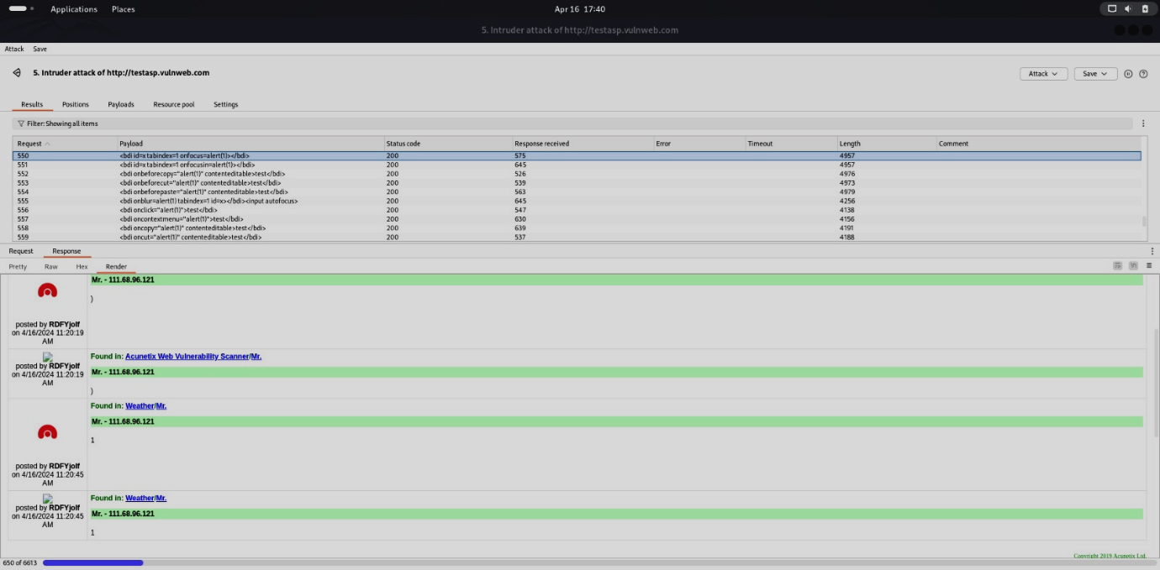
SCREENSHOTS

Slide 6
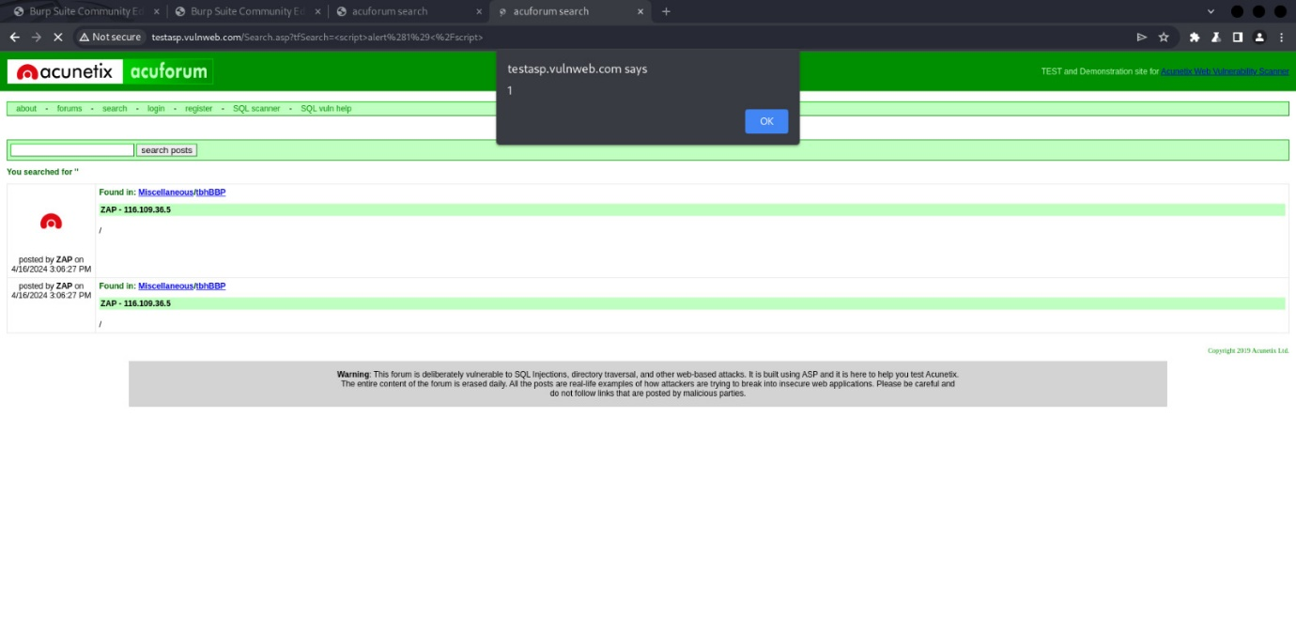
SCREENSHOTS

Slide 7
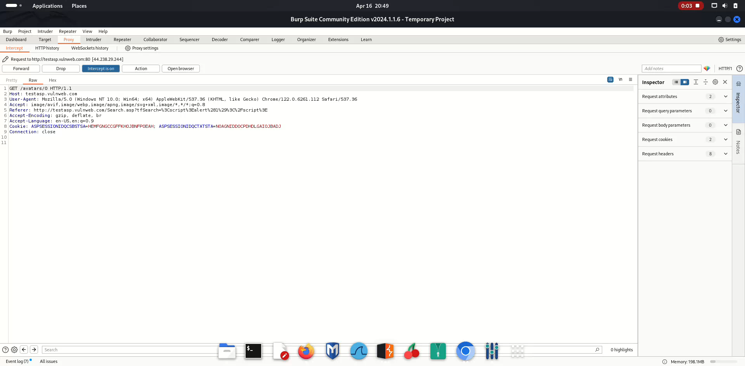
VIDEO REFERENCE

Slide 8
IMPACT
With user interaction, an attacker could execute arbitrary Javascript code in a victim's browser. This would allow an attacker to unwillingly make a victim:
Perform any action in the identified endpoint
View any information that the user is able to view
Modify any information that the user is able to modify (not sure if applicable in this case)
Interact with other application users as if it were him - impersonation (not sure if applicable in this case)

Slide 9
THANK
YOU

